Slide 1
Chemistry Review

Slide 2
Vocabulary
Density – how compact the atoms of a substance are.
Higher density – sink
Lower density-- float
Calculate: Density = Mass/Volume (g/mL)
Buoyancy – the force of a liquid pushing upward that causes a material to float.
Counteracts gravity
Always acts in the upward direction
Viscosity – how ‘thick’ a liquid is.
Very viscous = liquid flows slowly (ex: honey)
Low viscosity= liquid flows quickly (ex: water)

Slide 3
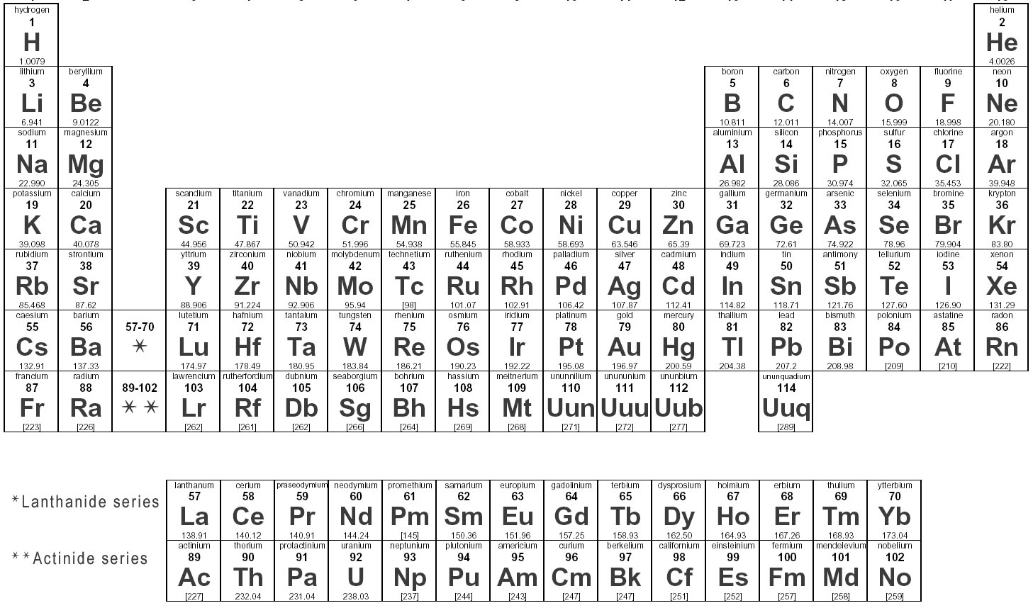
The periodic table
Columns on the periodic table are called: GROUPS
Groups are numbered from left to right
Group 1
Group 18

Slide 4
1. What group is Nitrogen in?
Answer the question on your notes page

Slide 5
Valence # : The number of outer electrons
Write these numbers at the top of your periodic table:
Valence #: 1 2 3 4 5 6 7 8

Slide 6
2. HOW MANY VALENCE ELECTRONS DOES Magnesium HAVE?
Answer the question on your notes page

Slide 7
Octet Rule: All atoms are stable when they have a 8 electrons = full outer shell
The whole reason atoms bond it to get 8 valence electrons!
Inert: Non-reactive. Elements that are already stable (already have 8 valence electrons) do not need to react with other elements.

Slide 8
3. Which group contains elements that are inert?
Answer the question on your notes page

Slide 9
4. HOW MANY VALENCE ELECTRONS DO ELEMENTS IN GROUP 16 HAVE?
Answer the question on your notes page

Slide 10
5. WHICH OTHER GROUP WILL ELEMENT GROUP16 BOND WITH IN ORDER TO FULFILL the octet rule (8 valence electrons)?
Answer the question on your notes page

Slide 11
Oxidation #: charge of an atom (ion) after it bonds.
Write these numbers at the bottom of your periodic table:
Oxidation #: 1+ 2+ 3+ 4 3- 2- 1- 0

Slide 12
Remember how group 2 and 16 will bond so that together the have 8 electrons?
Oxidation #: 1+ 2+ 3+ 4 3- 2- 1- 0
Elements in group 2 GIVE away their
Two valence electrons and become
POSITIVE
Elements in group 16 TAKE in the
two electrons and become
NEGATIVE

Slide 13
6. WHEN HYDROGEN BONDS, does it gain or lose electrons?
Answer the question on your notes page

Slide 14
7. WHEN Chlorine BONDS, does it gain or lose electrons?
Answer the question on your notes page

Slide 15
THE CRISS-CROSS METHOD:
When elements bond, they form a new compound.
To write the formula for this compound:
1. Write each element symbol.
2. Write the oxidation # of each element at the top right side of the symbol.
3. Cross the number part of the oxidation # to the bottom of the other element.
4. Rewrite the final formula.

Slide 16
EXAMPLE: Hydrogen and oxygen
1. Write each element symbol.
H O

Slide 17
EXAMPLE: Hydrogen and oxygen
2. Write the oxidation # of each element at the top right side of the symbol.
H¹⁺ O²⁻

Slide 18
EXAMPLE: Hydrogen and oxygen
3. Cross the number part of the oxidation # to the bottom of the other element.
H¹⁺ O²⁻
2
1

Slide 19
EXAMPLE: Hydrogen and oxygen
4. Rewrite the final formula.
But we generally don’t write the one. = H₂O
H₂O₁

Slide 20
8. USE THE CRISS-CROSS METHOD TO WRITE THE formula for these compounds:
Aluminum and oxygen
Sodium and chlorine
Potassium and sulfur
Boron and fluorine

Slide 21
Physical Changes
A physical change is just a change in the appearance of a substance, but its composition has not changed. All phase changes are physical changes.
Ex: cutting a sheet of paper into small pieces—its still paper.
Ex: melting ice– its still H₂O
A chemical change either bonds elements or splits them apart and creates a new substance. Evidence of chemical changes:
Bubbles/Odors – a new gas if formed
Color change- a new substance is formed
Heat is produced
Precipitate- grains of a new solid form in the bottom of a beaker.

Slide 22
Chemical changes
A chemical change either bonds elements or splits them apart and creates a new substance. Evidence of chemical changes:
Bubbles/Odors – a new gas if formed
Color change- a new substance is formed
Heat is produced
Precipitate- grains of a new solid form in the bottom of a beaker.
The TAKS test often asks about the rock cycle– any process that “weathers” rock by breaking it down or dissolving it is chemical change. Any process that makes a new rock or mineral is a chemical change.

Slide 23
Conservation of mass
When a chemical reaction takes place, no mass is lost, it just changes form.
REACTANTS PRODUCTS
(starting substances) (resulting substances)

Slide 24
Conservation of mass
When a chemical reaction takes place, no mass is lost, it just changes form.
REACTANTS PRODUCTS
(starting substances) (resulting substances)
1000 g of firewood = 300 grams of ash +
700 gram of smoke
Mass is conserved!

Slide 25
Balancing equations
H₂ + O₂ → H₂O
Equations must be balanced to satisfy the law of conservation of mass.

Slide 26
Balancing equations
2
H₂ + O₂ → H₂O
2
If you start with 2 atoms of oxygen
You must end with 2 atoms of oxygen
You must start
with 4 atoms of
hydrogen
And if you end
with 4 atoms of
hydrogen

Slide 27
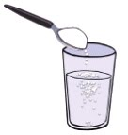
Solubility
Soluble = the ability to dissolve
Solute = substance that gets dissolved
Solvent = substance that does the dissolving

Slide 28
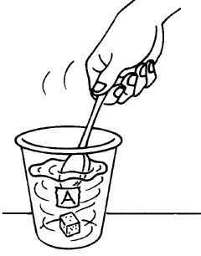
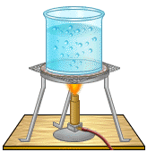
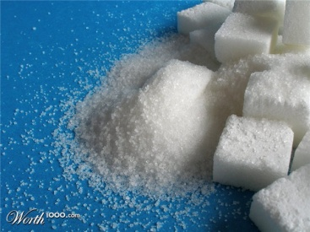
Increasing rate of dissolving
Increasing agitation (stirring)
Increasing temperature (heating)
Increasing surface area (crushing)

Slide 29
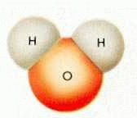
Water = POLAR
Water is known the UNIVERSAL SOLVENT
Water always has a ratio of 2 Hydrogen to 1 Oxygen
The oxygen is negatively charged
The hydrogen is positively charged
Because the hydrogen are both on one side, the water molecule becomes like a magnet. We say that it is POLAR.
It is the polar structure of water that makes it such a good solvent.
+
+
+
_
_

Slide 30
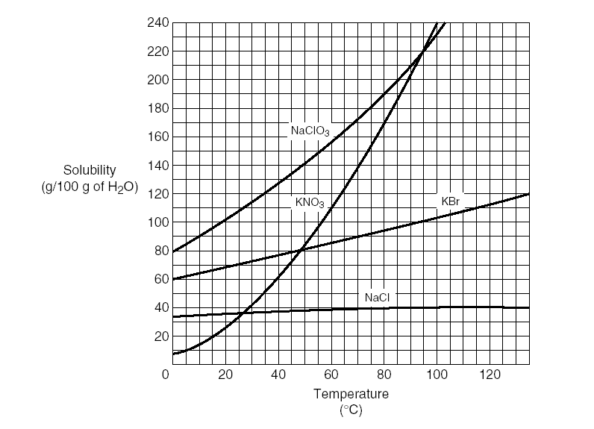
The solubility curve
How much solute can dissolve in 100 grams of water
at a given temperature

Slide 31
The solubility curve
A solution that falls ON the line is SATURATED. It has the maximum amount of solute that can dissolve

Slide 32
The solubility curve
A solution that falls BELOW the line is UNDERSATURATED. More solute can still dissolve

Slide 33
The solubility curve
A solution that falls ABOVE the line is SUPERSATURATED. There is too much solute. Some undissolved grains will remain the bottom of the beaker.

