Slide 1
Open-Ended Pipe
How can this make noise?
-hit with a mallet
-blow into one end
Both ends of the pipe will vibrate.
A vibrating section of a material is an
antinode.
The length between two antinodes is ___ λ.
Thus, L = ½ λ
1/2

Slide 2
Two types of open-ended pipes:
Different pipe length = Different frequencies
When the holes are covered, air
Comes out of the end – long wavelength
When a hole is open, air escapes there
Instead– short wavelength

Slide 3
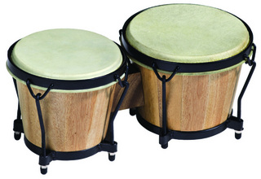
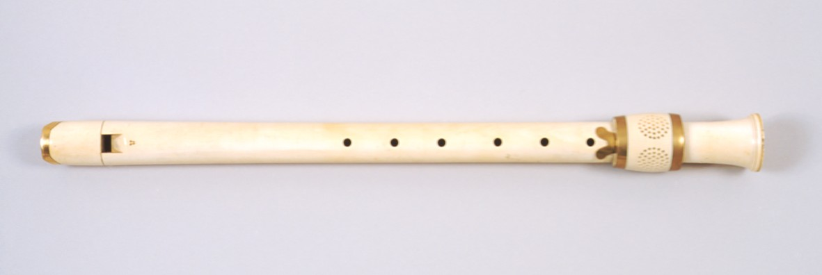
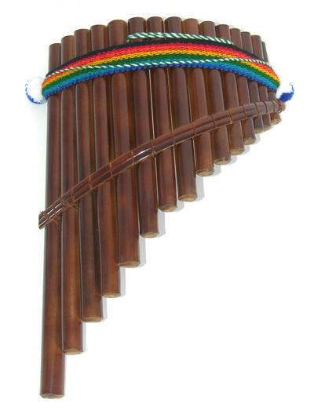
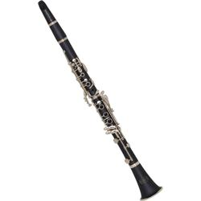
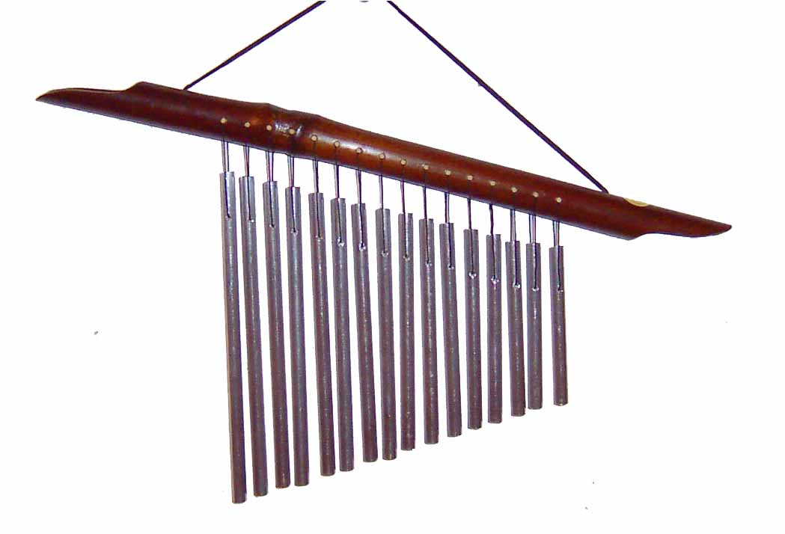
Examples of open-ended pipes:

Slide 4
Close-Ended Pipe
How can this make noise?
-hit with a mallet
-blow across the top
The closed end will not vibrate. This is a node.
The open end will vibrate. This is an antinode.
The length between a node and a antinode is ___ λ.
Thus, L = ¼ λ
1/4

Slide 5
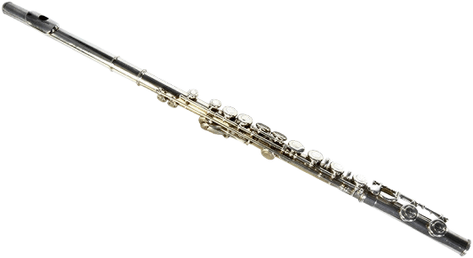
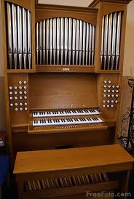
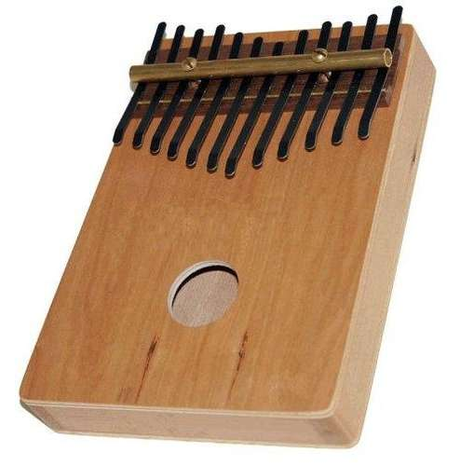
Examples of close-end pipes:

Slide 6
String
How can this make noise?
-pluck
The ends of the string are fixed. These are nodes.
The center of the string will vibrate. This is an antinode.
The length between two nodes is ___ λ.
Thus, L = ½ λ
1/2

Slide 7
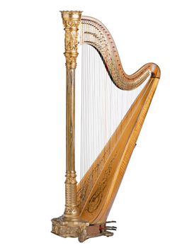
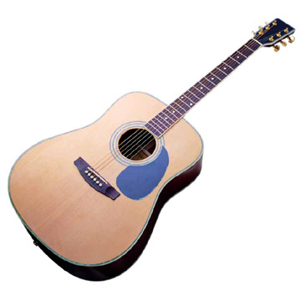
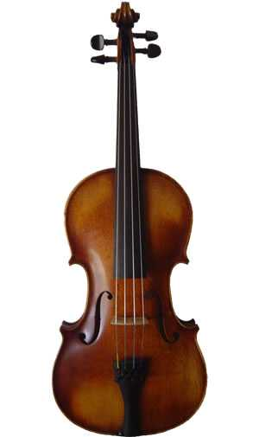
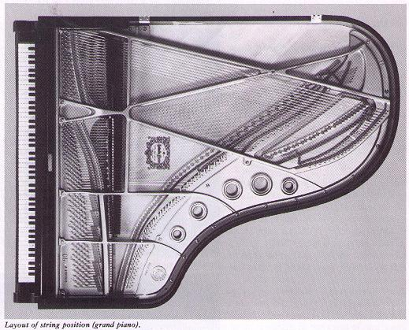
Examples of string instruments:

