Slide 1
Science Review Week 3
DNA and RNA

Slide 2
DNA
What: ‘deoxyribose nucleic acid’
genetic material
Why: makes identical copies
daughter cells
How: holds code for amino acids
codons proteins
traits

Slide 3
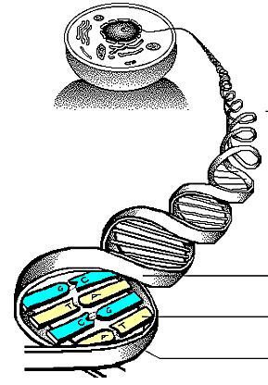
Components of DNA:
Located in the nucleus
Strand
Complement

Slide 4
Hydrogen Bond
Backbone
Deoxyribose (sugar)
Phosphate
Base Pairs
Nitrogen Bases
Nucleotides

Slide 5
Names of nucleotides
Adenine- Thymine
Guanine- Cytosine
A – T
C – G
A T
C G
The Code

Slide 6
RNA
DNA can’t move out of the nucleus
RNA makes copies of DNA and carries the code from DNA to the ribosomes.
** RNA doesn’t have Thymine. It uses Uracil.
A – U
G – C

Slide 7
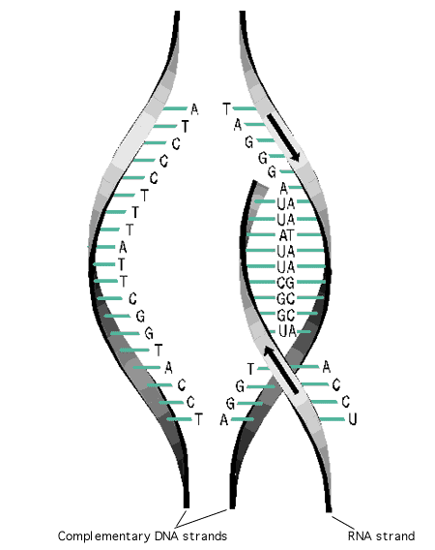
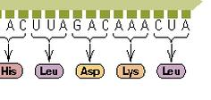
The copying process
The DNA double helix untwists itself.
The DNA double helix unzips itself
RNA makes a copy of one side of the DNA
(transcription)
4. RNA carries the copy to the ribosomes and instructs to make proteins (translation)

Slide 8
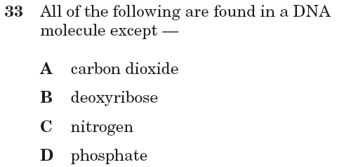

Slide 10
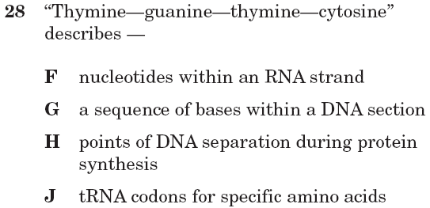
B.6A Fall 2005

Slide 11
B.6A Fall 2005

