Slide 1
Week 4 Science Review
Mutations and Inheritance

Slide 2
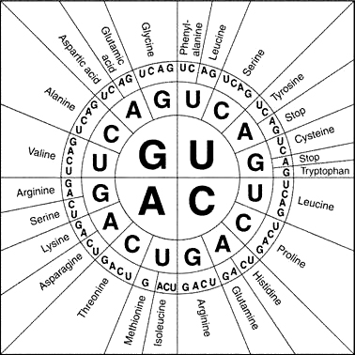

Slide 3
What amino acid sequence does the following RNA strand tell the ribosomes to make? GCGAAAUAG

Slide 4
v
What amino acid sequence does the following RNA strand tell the ribosomes to make? GCGAAAUAG
Alanine
Lysine
Stop

Slide 5
What amino acid sequence does the following RNA strand tell the ribosomes to make? CCUAGCGGA

Slide 6
What amino acid sequence does the following RNA strand tell the ribosomes to make? CCUAGCGGA
Proline -- Serine -- Glycine

Slide 7
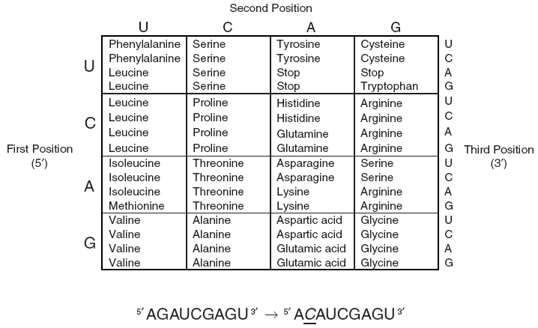
What amino acid sequence does the following RNA strand tell the ribosomes to make? GCGAAAUAG
Alanine
Lysine
Stop

Slide 8
What protein is made by the code GAU?
Aspartic Acid

Slide 9
Mutations
Point mutation – one base pair is changed
CAC = Histidine
CAG= Glutamine
A single change makes
a whole new amino acid

Slide 10
Mutations
AUACGAUAG
Point change = one base pair change
AUACGACAG
Deletion = section is missing
AUAUAG
Replication = section is repeated
AUACGAUAGUAG

Slide 11
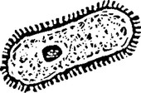
So one cell goes wrong. Big deal?
Cells copy themselves–
and the mutation goes with it.

Slide 12
Inheritance
If you have a mole on your arm, will your child also grow up with a mole on his arm?
If you get a stomach ulcer, will your child be born with a stomach ulcer?
Only mutations to egg or sperm cells (gametes)
will be passed on to your offspring.

Slide 13
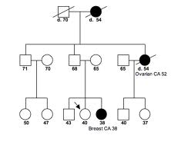
Some mutations only occur on the Y or X chromosome. This means the mutation is only inherited by the males or the females in the family.

Slide 14
This male has a mutation on
the Y chromosome
Who else will have the
mutation?

Slide 15
This male has a mutation on
the Y chromosome
Who else will have the
mutation?

Slide 16
WHY DID THIS GUY NOT GET
THE MUTATION

Slide 17
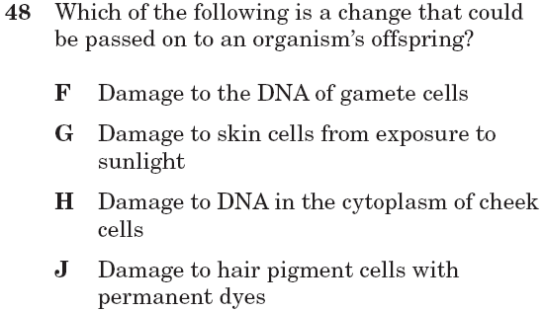
B.6C Feb 2006

Slide 18
B.6C Feb 2006

Slide 19
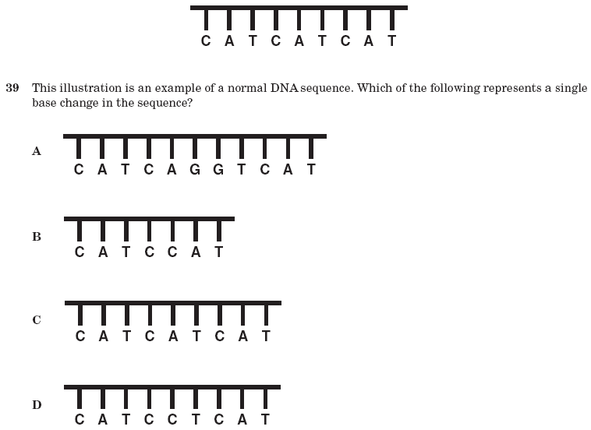
B.6C 10th April 2006

Slide 20
B.6C 10th April 2006

Slide 21
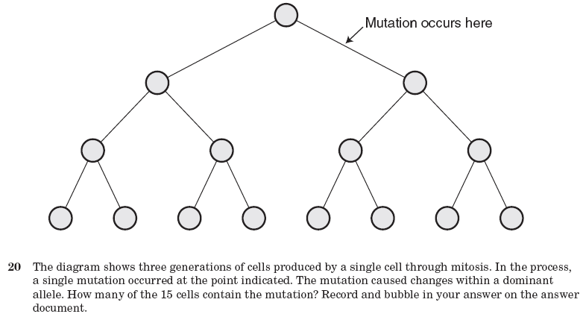
B.6C 10th April 2006

Slide 22
B.6C 10th April 2006
7

Slide 23
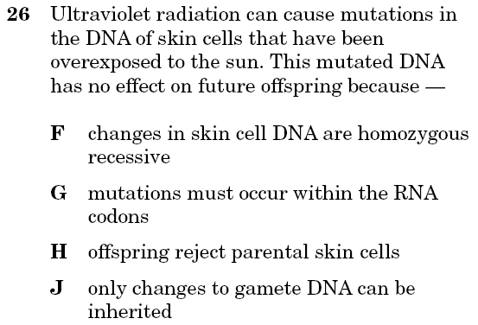
B.6C 10th April 2004

Slide 24
B.6C 10th April 2004

