Slide 1
Chemistry Review

Slide 2
Vocabulary
Density – how compact the atoms of a substance are.
Higher density – sink
Lower density-- float
Calculate: Density = Mass/Volume (g/mL)
Buoyancy – the force of a liquid pushing upward that causes a material to float.
Counteracts gravity
Always acts in the upward direction
Viscosity – how ‘thick’ a liquid is.
Very viscous = liquid flows slowly (ex: honey)
Low viscosity= liquid flows quickly (ex: water)

Slide 3
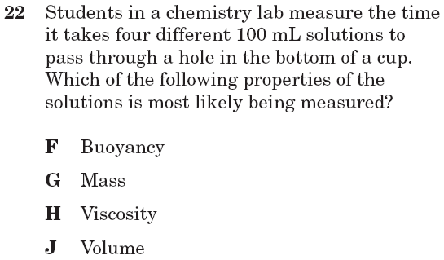
I.7A 10th April 2006

Slide 4
I.7A 10th April 2006

Slide 5
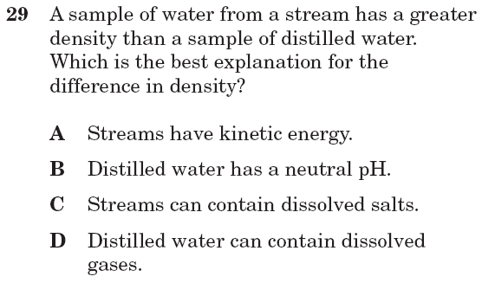
I.7A 10th April 2006

Slide 6
I.7A 10th April 2006

Slide 7
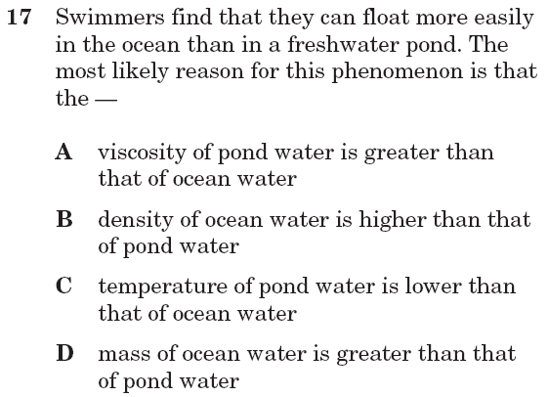
I.7A July 2004

Slide 8
I.7A July 2004

Slide 9
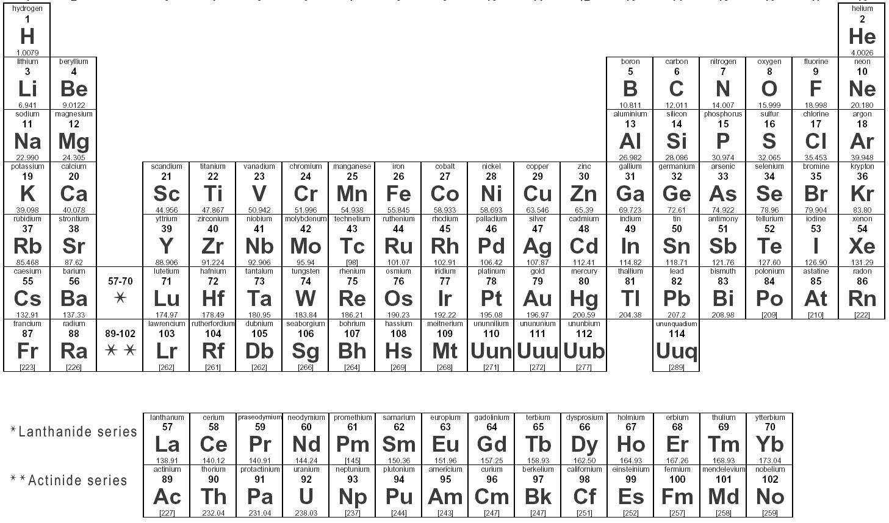
The periodic table
Columns on the periodic table are called: GROUPS
Groups are numbered from left to right
Group 1
Group 18

Slide 10
Think to yourself:
Do you know the difference between –
… an atom
… a molecule
… a compound
… and a mixture?

Slide 11
Atom – a single particle of an element.
Molecule- two or more atoms bonded together
Compound- two or more DIFFERENT atoms bonded together.
Mixture- two or more substances near each other but NOT bonded at the atomic level.

Slide 12
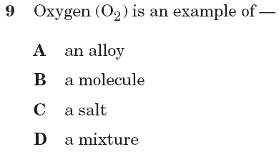
I.7E (10th only) Spring 2003

Slide 13
I.7E (10th only) Spring 2003

Slide 14
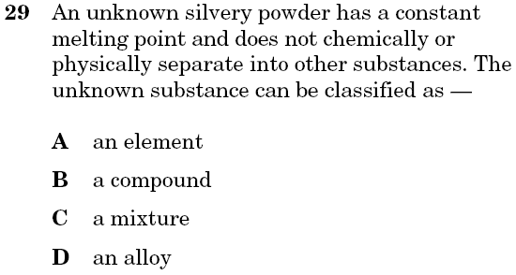
I.7E (10th only) April 2004

Slide 15
I.7E (10th only) April 2004

Slide 16
THE CRISS-CROSS METHOD:
When elements bond, they form a new compound.
To write the formula for this compound:
1. Write each element symbol.
2. Write the oxidation # of each element at the top right side of the symbol.
3. Cross the number part of the oxidation # to the bottom of the other element.
4. Rewrite the final formula.

Slide 17
EXAMPLE: Hydrogen and oxygen
1. Write each element symbol.
H O

Slide 18
EXAMPLE: Hydrogen and oxygen
2. Write the oxidation # of each element at the top right side of the symbol.
H¹⁺ O²⁻

Slide 19
EXAMPLE: Hydrogen and oxygen
3. Cross the number part of the oxidation # to the bottom of the other element.
H¹⁺ O²⁻
2
1

Slide 20
EXAMPLE: Hydrogen and oxygen
4. Rewrite the final formula.
But we generally don’t write the one. = H₂O
H₂O₁

Slide 21
Physical Changes
A physical change is just a change in the appearance of a substance, but its composition has not changed. All phase changes are physical changes.
Ex: cutting a sheet of paper into small pieces—its still paper.
Ex: melting ice– its still H₂O
A chemical change either bonds elements or splits them apart and creates a new substance. Evidence of chemical changes:
Bubbles/Odors – a new gas if formed
Color change- a new substance is formed
Heat is produced
Precipitate- grains of a new solid form in the bottom of a beaker.

Slide 22
Chemical changes
A chemical change either bonds elements or splits them apart and creates a new substance. Evidence of chemical changes:
Bubbles/Odors – a new gas if formed
Color change- a new substance is formed
Heat is produced
Precipitate- grains of a new solid form in the bottom of a beaker.
The TAKS test often asks about the rock cycle– any process that “weathers” rock by breaking it down or dissolving it is chemical change. Any process that makes a new rock or mineral is a chemical change.

Slide 23
Chemical or Physical Change?

Slide 25
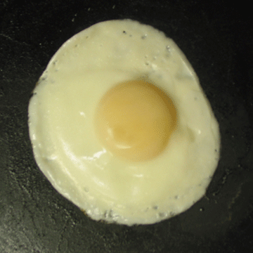

Slide 26
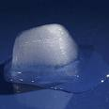

Slide 27
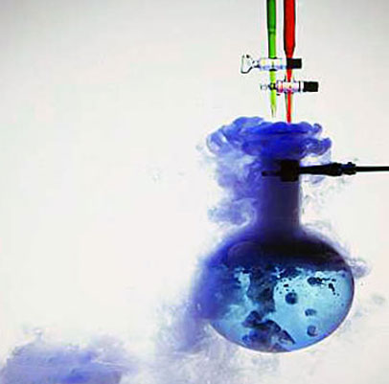

Slide 28
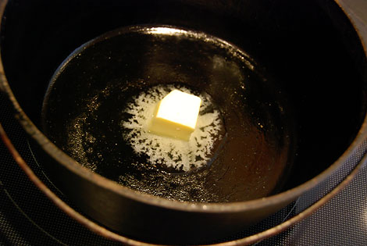

Slide 29
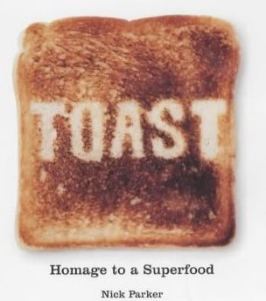

Slide 30
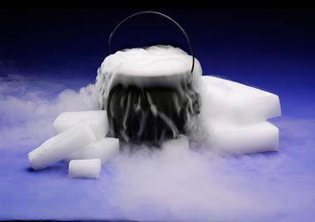

Slide 31
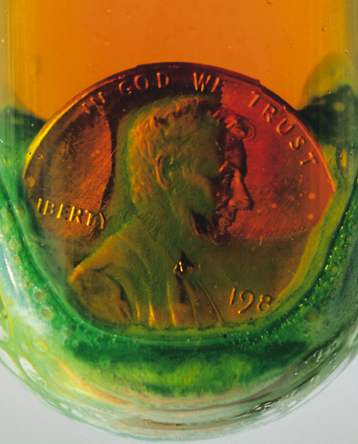

Slide 32
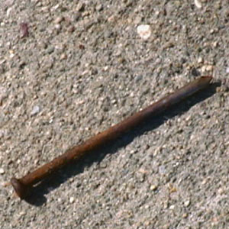

Slide 33
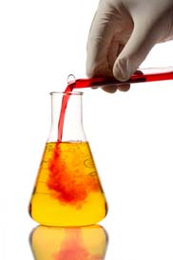

Slide 34
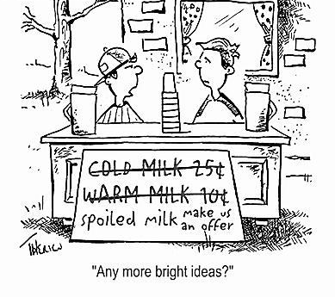

Slide 36
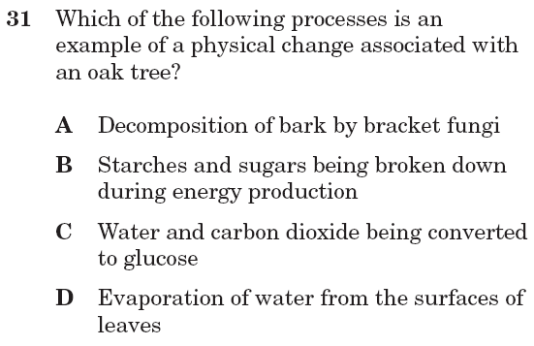
I.7A July 2004

Slide 37
I.7A July 2004

Slide 38
Conservation of mass
When a chemical reaction takes place, no mass is lost, it just changes form.
REACTANTS PRODUCTS
(starting substances) (resulting substances)

Slide 39
Conservation of mass
When a chemical reaction takes place, no mass is lost, it just changes form.
REACTANTS PRODUCTS
(starting substances) (resulting substances)
1000 g of firewood = 300 grams of ash +
700 gram of smoke
Mass is conserved!

Slide 40
Balancing equations
H₂ + O₂ → H₂O
Equations must be balanced to satisfy the law of conservation of mass.

Slide 41
Balancing equations
2
H₂ + O₂ → H₂O
2
If you start with 2 atoms of oxygen
You must end with 2 atoms of oxygen
You must start
with 4 atoms of
hydrogen
And if you end
with 4 atoms of
hydrogen

Slide 42
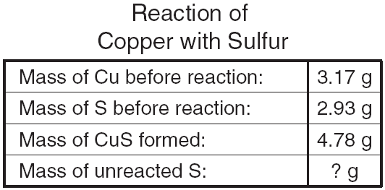
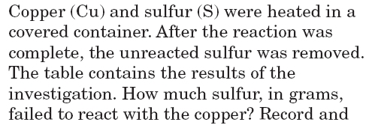

Slide 43
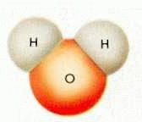
Water = POLAR
Water is known the UNIVERSAL SOLVENT
Water always has a ratio of 2 Hydrogen to 1 Oxygen
The oxygen is negatively charged
The hydrogen is positively charged
Because the hydrogen are both on one side, the water molecule becomes like a magnet. We say that it is POLAR.
It is the polar structure of water that makes it such a good solvent.
+
+
+
_
_

Slide 44
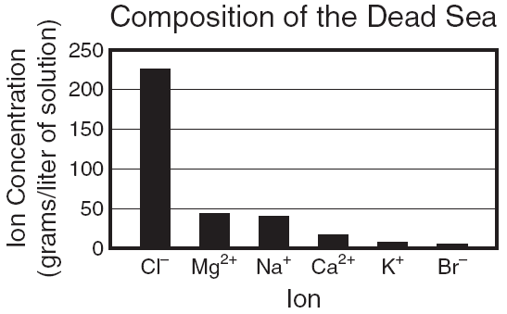
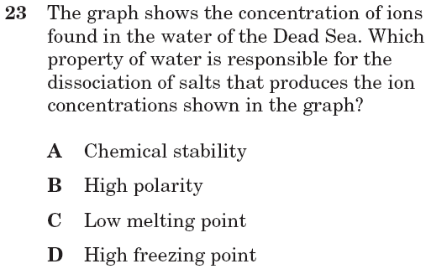
I.8A Feb 2006

Slide 45
I.8A Feb 2006

