Slide 1
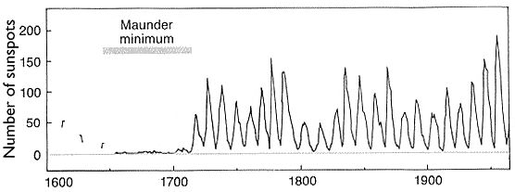
Sun spot activity increases and decreases on a regular cycle.
When will the next increase in sunspot activity occur?
1990
1995
2001
2006

Slide 2
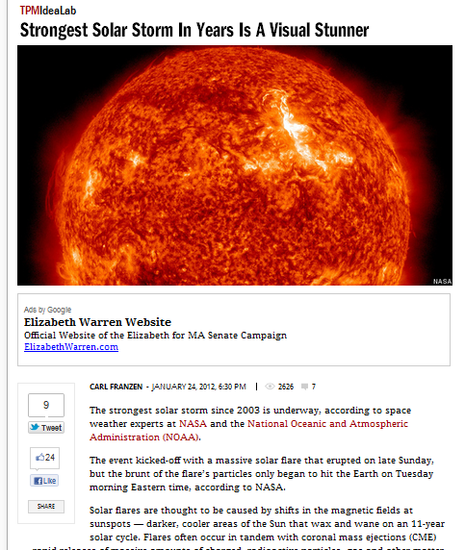

Slide 3
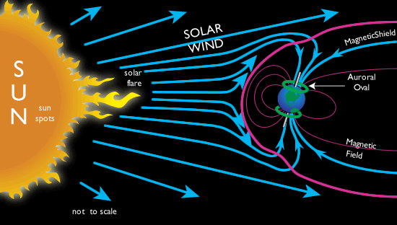

Slide 4
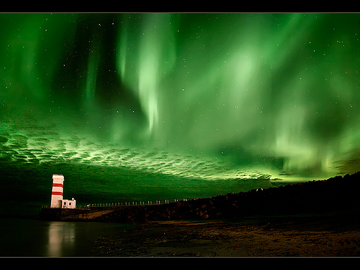

Slide 5
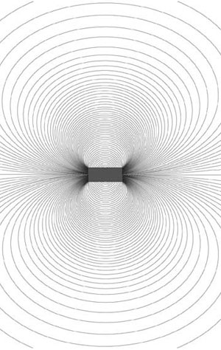
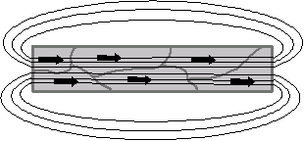
Magnetism Notes:
Magnetism is similar to electrostatics
a. magnets have a north and south pole (not + and -)
b. Like poles repel and opposite poles attract
2. Magnetic field lines:
a. leave the north pole and enter the south pole of a magnet
b. are closer together where the field is stronger.
3. ‘Ferromagnetic’ materials can become magnetized because their atoms
can rotate to align with an external magnetic field.
4. The earth’s magnetic north pole is actually at the geographic south pole!

Slide 6
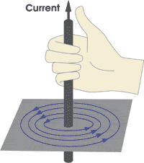
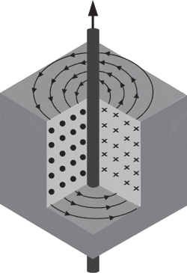
Electricity and Magnetism
1. Electrical currents create magnetic fields.
2. The direction of the magnetic field can be determined using the
RIGHT HAND RULE:
a. thumb in the direction of the current
b. fingers curl in the direction of the magnetic field
3. Magnetic fields can be drawn using these symbols:
I = current
B = magnetic field
x = going into the surface (tail of arrow)
= coming out of the surface (tip of arrow)

Slide 7
Try these on the back of your Lab:
The direction of electrical current (I) is shown below, draw the magnetic field (B):
a. x b. •
c. d.

Slide 8
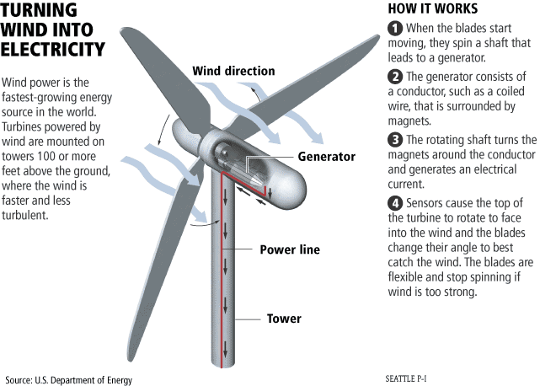
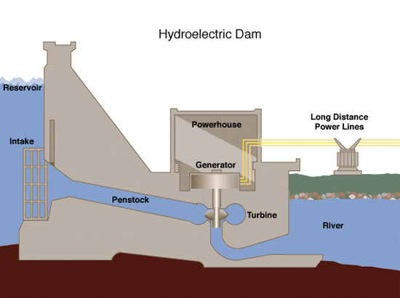
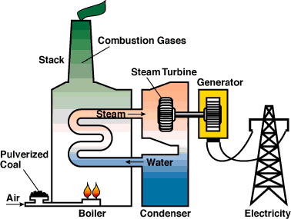
Electricity and Magnetism
Magnets can create electricity:
Electrons in a wire will align themselves within the magnetic field.
When the magnet moves along the wire, the electrons move too, causing an electrical current.
Anything that creates electricity by turning (wind turbines, water turbines, hand cranks, etc.) uses this principle:

Slide 9
Current
Direct Current- electrons flow one direction
- batteries
Alternating Current- electrons flow back and forth 60 times per second
- electrical grid in the US
- wall socket = 120 V

Slide 10
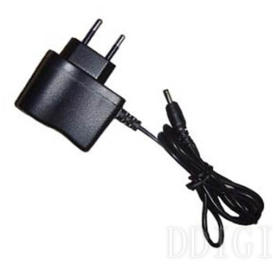
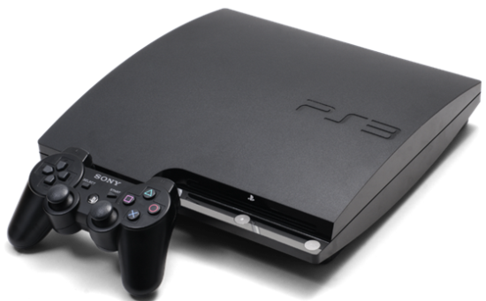
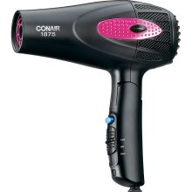
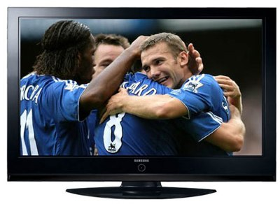
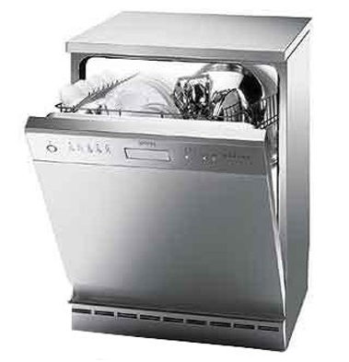
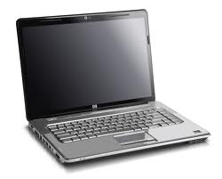
Match the Power Rating to the Appliance:
2000 W
1200 W
285 W
150 W
48 W
0.5 W

Slide 11
Match the Power Rating to the Appliance:
1890 W
1200 W
285 W
150 W
48 W
0.5 W

Slide 12
Electrical Power:
Power = Voltage x Current P=VI
Power measures the amount of energy used in a given amount of time.
Units = Watts
Ex: A standard light bulb is 60 Watts. If it is plugged into a 120 V wall outlet, how much current does it draw?

Slide 13
Electrical Bills
Consumers are billed for total energy used.
Energy = Power x time
Energy Rates are generally set per kW-hr
Ex: How much energy does a Playstation 3 use in a month?
If Austin Energy charges $0.0355 during the winter. How much did it cost to run this game console during January?

Slide 14
Voltage
Current
Resistance
DC
AC
Series
Parallel

